Slide 1
Java Programming
Conditionals

Slide 2
Outline
BMI problem
Control structures
Conditional statements
Block
If statement
Recursion
BodyMassIndex.java
Blackbox and Contract
Javadoc comments
Switch statement

Slide 3
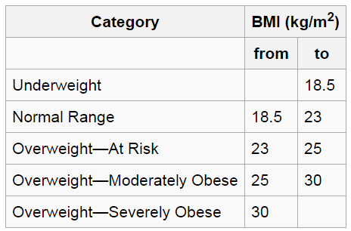
Body Mass Index (BMI)
The BMI is defined as the body mass divided by the square of the body height. The Hospital Authority of Hong Kong recommends the use of the following BMI ranges.
check yourself ☺

Slide 4
Control structures
Control structures are special instructions that can change the flow of control.
There are two basic types of control structure: loops and branches.
branches allow the computer to decide between two or more different courses of action by testing conditions that occur as the program is running.
Loops allow a sequence of instructions to be repeated over and over.

Slide 5
Blocks
The block is the simplest type of structured statement. Its purpose is simply to group a sequence of statements into a single statement. The format of a block is:
{
STATEMENTS
}

Slide 6
Conditional statements
Only one branch
if (CONDITION) { STATEMENTS }
With two branches
if (CONDITION) { STATEMENTS } else { STATEMENTS }
The CONDITION in parentheses is a condition expression whose type must be boolean.

Slide 7
Example
int x=8;
if (x % 2 == 0) {
System.out.println(x+" is even");
} else {
System.out.println(x+" is odd");
}

Slide 8
Example
Note: The braces are optional for branches that have only one statement. So we can rewrite the previous example this way:
int x=8;
if (x % 2 == 0)
System.out.println(x+" is even");
else
System.out.println(x+" is odd");
Note: It’s better to use braces to avoid making mistakes.

Slide 9
Chaining and nesting
Chaining
if (CONDITION) { STATEMENTS } else if (CONDITION) { STATEMENTS } else { STATEMENTS }
Nesting
if (CONDITION) { STATEMENTS } else {
if (CONDITION) { STATEMENTS } else STATEMENTS
} }

Slide 10
Example
int x=9;
if (x > 0) {
System.out.println("x is positive");
} else if (x < 0) {
System.out.println("x is negative");
} else {
System.out.println("x is zero");
}
int x=9;
if (x > 0) {
System.out.println("x is positive");
} else {
if (x < 0) {
System.out.println("x is negative");
} else {
System.out.println("x is zero");
}
}
Note: It’s better to use chaining if possible, because it is more readable

Slide 11
Body Mass Index (BMI)
The BMI is defined as the body mass divided by the square of the body height. The Hospital Authority of Hong Kong recommends the use of the following BMI ranges.

Slide 12
BodyMassIndex.java
import java.util.Scanner;
public class BodyMassIndex {
public static void main(String[] args) {
Scanner in = new Scanner(System.in); System.out.println(“height is ? meters”); double height= in.nextDouble(); System.out.println(“weight is ? kg”); double weight= in.nextDouble(); showCategory(calcBMI(height,weight));
}
public static double calcBMI(double m, double kg) {…}
public static void showCategory (doube bmi) {…}
}

Slide 13
BodyMassIndex.java
public static double calcBMI(double m, double kg) {
return kg/(m*m);
}
public static showCategory(double bmi) {
String s=“Underweight”;
if (bmi>18.5 && bmi<=23) s=“Normal Range”;
else if(bmi>23 && bmi<=25) s=“OverWeight-At risk”;
else if(bmi>18.5 && bmi<=30) s=“OverWeight-Moderately Obese”;
else if(bmi>30) s=“OverWeight-Severly Obese”;
System.out.print(“your BMI is %.2f, %s!”,bmi, s);
}

Slide 14
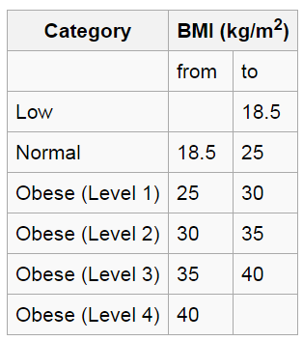
BodyMassIndex.java
Assume this program will be released as an Android App, the users are from all over the world.
And in different country, the BMI ranges are different.
For example, Japan Society for the Study of Obesity recommends the following BMI ranges→.

Slide 15
BodyMassIndex.java
import java.util.Scanner;
public class BodyMassIndex {
public static void main(String[] args) {
Scanner in = new Scanner(System.in); System.out.println(“height is ? (meters)”); double height= in.nextDouble(); System.out.println(“weight is ? (kg)”); double weight= in.nextDouble(); showCategory(calcBMI(height,weight));
}
public static double calcBMI(double m, double kg) {…}
public static void showCategory (doube bmi) {…}
}

Slide 16
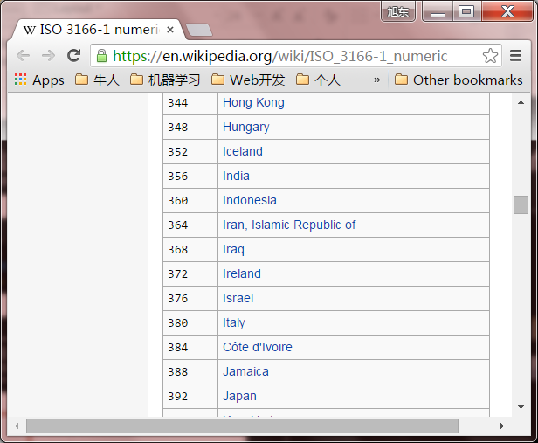
BodyMassIndex.java
public static double calcBMI(double m, double kg) {
return kg/(m*m);
}
public static void showCategory(double bmi) {
int region = getRegionID();
if(region==344) showHongKongCategory(bmi);
else if(region==392) showJapanCategory(bmi);
//else if …;
}
// assume this function can return the region ID
public static int getRegionID() {…}
Notes:
https://en.wikipedia.org/wiki/ISO_3166-1_numeric

Slide 17
BodyMassIndex.java
public static void showHongKongCategory(double bmi) {
String s=“Underweight”;
if (bmi>18.5 && bmi<=23) s=“Normal Range”;
else if(bmi>23 && bmi<=25) s=“OverWeight-At risk”;
else if(bmi>18.5 && bmi<=30) s=“OverWeight-Moderately Obese”;
else if(bmi>30) s=“OverWeight-Severly Obese”;
System.out.print(“your BMI is %.2f, %s!”,bmi, s);
}
public static void showJapanCategory(double bmi) {…}

Slide 18
Well done?
If there is an input error that make the value of height equals zero, what will happen?
How to solve this problem?
Modify the main method?
Or modify the BMI method?

Slide 19
BodyMassIndex.java (modified)
import java.util.Scanner;
public class BodyMassIndex {
public static void main(String[] args) {
Scanner in = new Scanner(System.in);
System.out.println(“height is ? (meters)”);
double height= in.nextDouble();
System.out.println(“weight is ? (kg)”);
double weight= in.nextDouble();
if(weight >0 && height >0)
showCategory(BMI(height,weight));
else
System.out.println(“input error!”)
}
…
}

Slide 20
Well done?
As an Android App, the user may be from all over the world, and there are different standards for the BMI ranges.
Should we define different showXXXXCategory methods for all the different standards?
We will talk about this question in the future.

Slide 21

Can a method call itself?

Slide 22

Recursion
Recursion in computer science is a method where the solution to a problem depends on solutions to smaller instances of the same problem.
Recursion occurs when a thing is defined in terms of itself or of its type.
There are not only recursive methods but also recursive classes.

Slide 23
Recursive method
A method which can call itself directly (or indirectly) is called recursive method.
The recursive method can be defined by two properties:
A simple base case (or cases)—a terminating scenario that does not use recursion to produce an answer
A set of rules that reduce all other cases toward the base case
The recursive method use conditional statements to check whether the cases are satisfied or not

Slide 24
Fibonacci sequence
The Fibonacci sequence is a classic example of recursion.
Basic cases
Fib(0)=0;
Fib(1)=1;
Recursion rules for other cases
For all integers n>1, Fib(n) = Fib(n-1)+Fib(n-2)

Slide 25
Fibonacci sequence
public static int fib(int n) { if (n == 0 || n==1) { return n; } else { return fib(n-1)+fib(n-2); } }

Slide 26
Factorial
Factorial is another classic example of recursion.
Basic cases
fact(1)=1;
Recursion rules for other cases
For all integers n>1, fact(n)=n*fact(n-1);

Slide 27
Factorial
public static int fact (int n) { if (n==1) { return n; } else { return n*fact(n-1); } }

Slide 28
Well done?
Try it!
System.out.println(fact(20));
The result is -2102132736
The result should be 2432902008176640000

Slide 29
A better version
public static long fact (long n) {
if (n>21) return -1; if (n==1) { return n; } else { return n*fact(n-1); } }

Slide 30
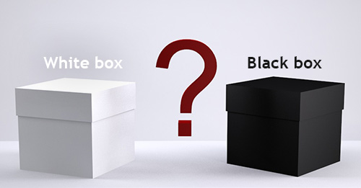
“black box”
A method is sometimes said to be a “black box”
A black box needs some kind of interface with the rest of the world, which allows some interaction between what’s inside the box and what’s outside.
The interface of a black box should be fairly straightforward, well-defined, and easy to understand.
To use a black box, you shouldn’t need to know anything about its implementation; all you need to know is its interface.

Slide 31

“contract”
The interface also includes a specification of what the box does and how it can be controlled by using the elements of the interface.
we can refer to both parts of the interface—syntactic and semantic —collectively as the contract of the method.
When you write a method, the comments that you write for the method should make the contract very clear.

Slide 32
Preconditions & postconditions
A convenient way to express the contract of a subroutine is in terms of preconditions and postconditions.
A precondition of a subroutine is something that must be true when the subroutine is called, if the subroutine is to work correctly.
For example, for the built-in function Math.sqrt(x), a precondition is that the parameter, x, is greater than or equal to zero, since it is not possible to take the square root of a negative number.

Slide 33
Preconditions & postconditions
A postcondition of a subroutine represents the other side of the contract. It is something that will be true after the subroutine has run (assuming that its preconditions were met—and that there are no bugs in the subroutine).
For example, the postcondition of the function Math.sqrt() is that the square of the value that is returned by this function is equal to the parameter that is provided when the subroutine is called.

Slide 34
Preconditions & postconditions
Methods are sometimes described by comments that explicitly specify their preconditions and postconditions.
The comments are given in the form of Javadoc comments, but we can explicitly label the preconditions and postconditions.

Slide 35
Javadoc comments
begins with /** and ends with */
Javadoc comments can be used to describe methods, member variables, and classes. And they always immediately precede the thing it is commenting on.
Like any comment, a Javadoc comment is ignored by the computer when the file is compiled.
But there is a tool called javadoc that reads Java source code files, extracts any Javadoc comments that it finds, and creates a set of Web pages which can help us to understand how to use the methods.

Slide 36
Javadoc comments
There are many tags which can help the javadoc tool to create nicely formatted, interlinked web pages from the Javadoc comments.
Some frequently used tags are as follows:
@author
@version
@param
@return
@see
@deprecated

Slide 37
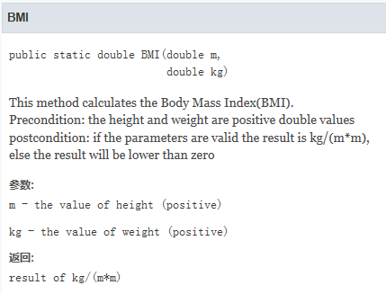
Javadoc comments
/**
* This method calculates the Body Mass Index(BMI).
* Precondition: the height and weight are positive double values
* postcondition: if the parameters are valid the result is kg/(m*m),
* else the result will be lower than zero
* @param m the value of height (>0)
* @param kg the value of weight (>0)
* @return result of kg/(m*m) */
public static double BMI(double m, double kg) {
return kg/(m*m);
}

Slide 38
Javadoc demo

Slide 39
Switch statement
switch EXPRESSION {
case CONSTANT1:
STATEMENTS1;
break;
case CONSTANT2:
STATEMENTS2;
break;
default:
STATEMENTS-Default;
}

Slide 40
Switch statement
A switch statement allows us to test the value of an expression and, depending on that value, to jump directly to some location within the switch statement.
The value of the expression can be one of below types:
int, short, byte, char, String, or enum.
In particular, note that the expression cannot be a double or float value.

Slide 41
Switch statement
The positions within a switch statement to which it can jump are marked with case labels that take the form: “case CONSTANT:”
CONSTANT is a literal of the same type as the expression in the switch.
As the final case in a switch statement you can, optionally, use the label “default:”

Slide 42
Switch statement
The break statements in the switch are technically optional. The effect of a break is to make the computer jump past the end of the switch statement, skipping over all the remaining cases.
If you leave out the break statement, the computer will just forge ahead after completing one case and will execute the statements associated with the next case label.

Slide 43
What is the output?
public static void main(String[] args){
byte a = 2;
switch(a){
case 1 : System.out.println(" A ");
case 2 : System.out.println(" B ");
case 3 : System.out.println(" C ");
case 4 : System.out.println(" D ");
default : System.out.println(" default ");
}
}

Slide 44
BodyMassIndex.java
public static void showCategory(double bmi) {
// assume this function can return the region ID
int region = getRegionID();
switch region{
case 344:
showHongKongCategory(bmi);
break;
case 392:
showJapanCategory(bmi);
break;
}
}
public static int getRegionID() {…}
Notes:
https://en.wikipedia.org/wiki/ISO_3166-1_numeric

Slide 45
Quiz
Define a method to determine whether a year is a leap year or a common year in the Gregorian calendar, the algorithm (pseudocode) is described below:
if (year is not divisible by 4) then (it is a common year)
else if (year is not divisible by 100) then (it is a leap year)
else if (year is not divisible by 400) then (it is a common year)
else (it is a leap year)

Slide 46


